Slide 1
Week 1B – Introduction to LabVIEW
Advanced Mechatronics System Design – MANU2451
Dr Chow Yin LAI
Edited by Dr Milan Simic School of Engineering RMIT University, Victoria, Australia Email: milan.simic@rmit.edu.au

Slide 2
Teaching Schedule
Week |  | Class Activity Before | Lecture | Class Activity During or After
1 |  |  | Introduction to the Course / Introduction to LabVIEW | LabVIEW Programming
2 |  |  | Introduction to LabVIEW / Data Acquisition | LabVIEW Programming
3 |  |  | Gripper / Introduction to Solidworks / Safety | Gripper Design
4 |  |  | Sensors I | myRIO Programming for Sensor Signal Reading / Gripper Design
5 |  |  | Sensors II | myRIO Programming for Sensor Signal Reading
6 |  |  | Actuators I | 3D Printing
7 |  | LabVIEW Assessment. | DC Motors I | Matlab Simulink Simulation
8 |  | Design report submission | DC Motors II | Matlab Simulink Simulation / myRIO Programming for Control
9 |  |  | Actuators II | Matlab Simulink Simulation / Assemble Gripper
10 |  |  | Modeling and System Identification | Matlab Simulink Simulation / Test Gripper
11 |  |  | Artificial Intelligence I | Matlab Simulation / Finalize Gripper
12 |  | Gripper Demonstration / Submission of Report | Artificial Intelligent II | Revision

Slide 3
Mechatronics System Components
D/A, Amplifier, PWM etc.
Output Signal Conditioning and Interfacing
Actuators
Sensors
Input Signal Conditioning and Interfacing
Digital Control Architectures
Microcontroller, Control Algorithm, PLC, etc.
DC Motor, Stepper,
Servo etc.
Mechanical
Computer
Electrical / Electronics
Control Systems
Potentiometer, Strain gauge, Encoder etc.
A/D, Filters, Amplifiers etc.

Slide 4
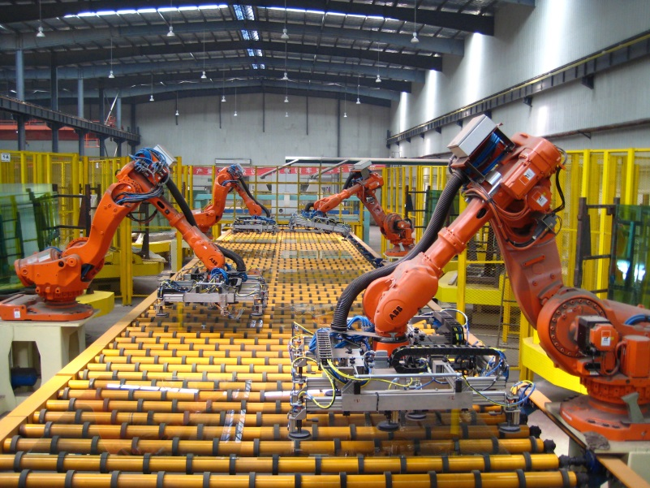
Mechatronics System Components
Sensors: Encoder at each joint
Input signal interfacing
Robot controller:
Generate desired motion trajectory
Calculate current end-effector position based on angular position (kinematics)
Calculate desired angular position for desired end-effector position and trajectory (inverse kinematics)
Control algorithm
Safety, collision detection etc.
Industrial Robots
https://commons.wikimedia.org/wiki/File:Float_Glass_Unloading.jpg
Actuators: Geared motor at each joint
Output signal interfacing

Slide 5
Digital Control Architecture
In this course, we will be using National Instruments myRIO 1900 as the “brain” for the Mechatronic device.
Read in sensor values.
Calculate control signals and perform logical operations.
Send out control signals to control the device.
The programming language for the myRIO device is LabVIEW.
Hence we will learn how to program in LabVIEW today.

Slide 6
Content
Introduction to LabVIEW
The LabVIEW Environment
Getting Started
LabVIEW Foundations

Slide 7
Content
Introduction to LabVIEW
The LabVIEW Environment
Getting Started
LabVIEW Foundations

Slide 8
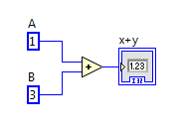
What is LabVIEW?
Short for Laboratory Virtual Instrument Engineering Workbench.
A graphical programming environment, instead of text. E.g.
Advantages:
Hassle free. No fuss with pointers, memory allocation, syntax such as semicolons and curly braces.
The concept of dataflow is familiar to scientists and engineers. One can learn LabVIEW even with little or no programming experience.
Int A = 1;
Int B = 3;
Int Z;
Z = X + Y;
Text-based programming
Graphical programming,
“G” Language

Slide 9
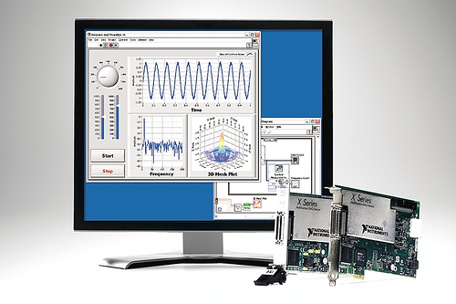
What is LabVIEW?
LabVIEW is also much more than a programming language.
It is specifically designed to take measurements, analyze data, and present results to the user.
LabVIEW can command plug-in data acquisition (DAQ) devices to acquire or generate analog and digital signals.
E.g. read in sensor signal from load cell, encoder.
E.g. send out analog voltage of PWM signal.
Once the data is acquired, then use LabVIEW functions to process and manipulate it.
LabVIEW with Measurement Devices
https://www.flickr.com/photos/national_instruments/3794634513

Slide 10
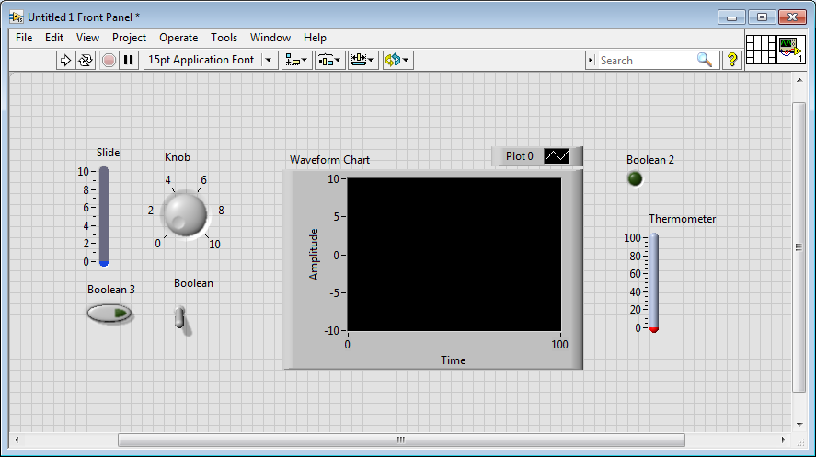
LabVIEW Program
Consists of one or more “virtual instruments (VI)”.
Appearance and operation often imitate actual physical instruments.
A VI has three main parts:
Front panel
Interactive user interface
Simulates the front panel of physical instruments
Can contain knobs, push buttons, graphs, user inputs and indicators.

Slide 11
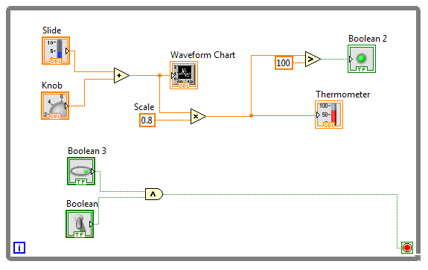
LabVIEW Program
Block diagram
Source code.
The actual executable program.
Block diagram has corresponding front panel objects, so data can pass from user to program and back to user.

Slide 12
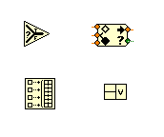
LabVIEW Program
Icon
To use a VI as a subroutine for another VI, it must have an icon with connector.
Called “SubVI”

Slide 13
Content
Introduction to LabVIEW
The LabVIEW Environment
Getting Started
LabVIEW Foundations

Slide 14
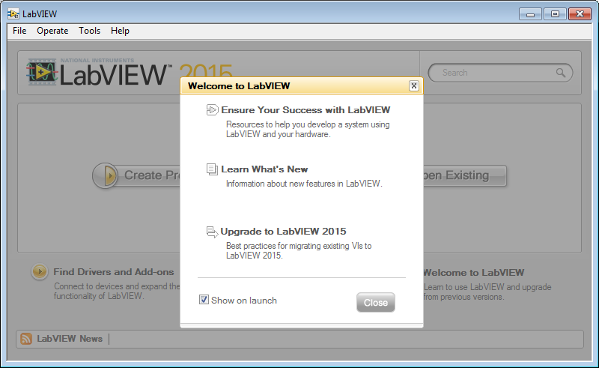
LabVIEW Project
Launch LabVIEW
Click Close on pop-up dialogue

Slide 15
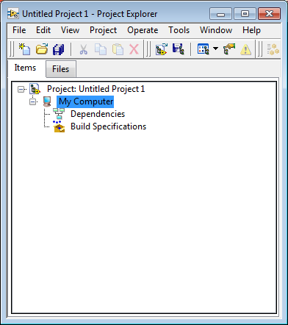
LabVIEW Project
Click on Create Project
Choose “Blank Project” → Finish.
The Project Explorer window will appear (as shown on the right).
Project allows you to organize your VI.
When you save your project, LabVIEW creates a project file (.lvproj).
It stores the files contained in the project, configuration, build and deployment information.
Note: “My Computer” is the “target” in this project → where the VI will be deployed.

Slide 16
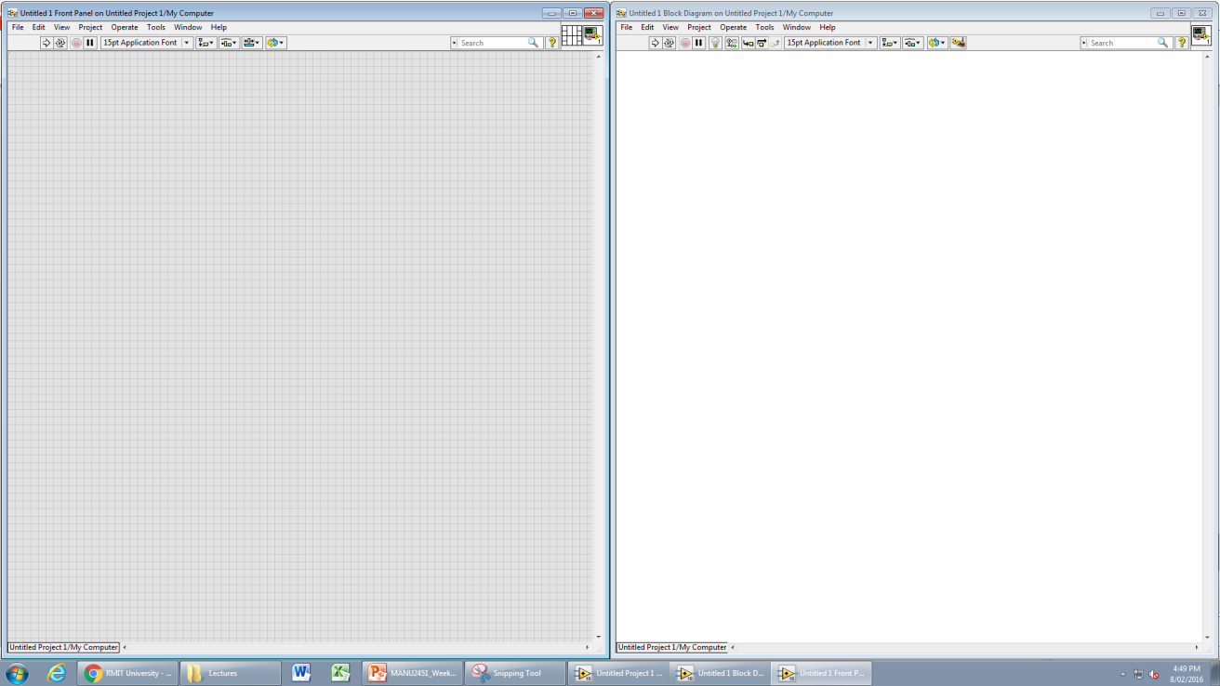
Adding Items to Project
Highlight the “My Computer” and right click.
Choose New → VI
You will get a “Front Panel” and a “Block Diagram” window.
Go to “Windows” → “Tile Left and Right” (Optional):

Slide 17
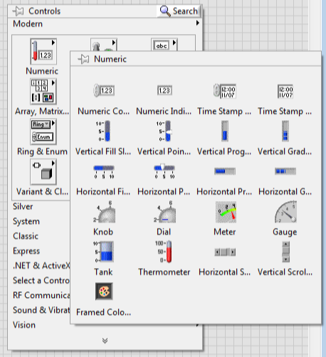
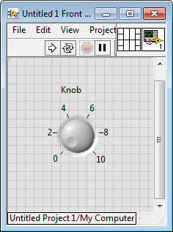
Front Panels
If you right click on the Front Panel, you will see a list of items (Controls and Indicators) for you to choose.
Controls allow user to input values.
Indicators show the output values produced by the program.
Select and drop the item onto your front panel.

Slide 18
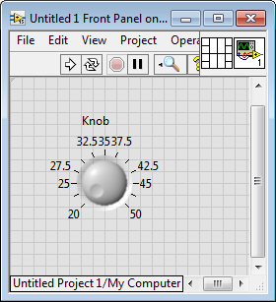
Front Panels
You can then resize the object if you want.
Also, by default the item has a range of 0 to 10.
If you would like another range, say 20 to 50,
Click on 0 and change to 20
Click on 10 and change to 50

Slide 19
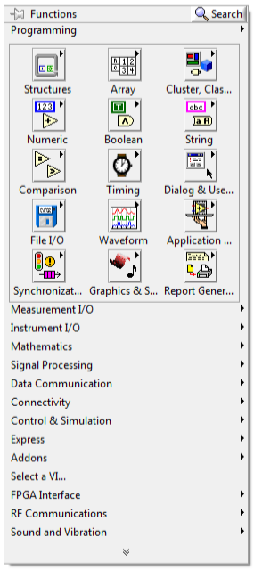
Block Diagram
Note: When you dropped a control onto the front panel, a corresponding item appears on the block diagram as well.
It will be expecting values the user enter through the front panel, and uses that value in block diagram for operations.
Now you would like to create a program to do something about the knob value.
Right click on the block diagram.
A list of functions will be provided.
Note that this list is different from the ones given on front panel previously.

Slide 20
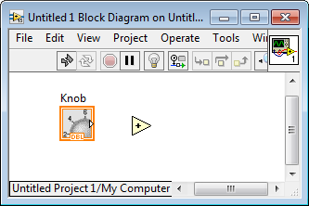
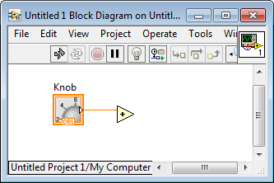
Block Diagram
Choose “Add” from Numeric and place it to the right of the knob.
When you hover your mouse around the right triangle of the knob, the mouse will change to the wiring tool.
Click and drag a wire until it connects with one terminal of the “Add” icon.

Slide 21
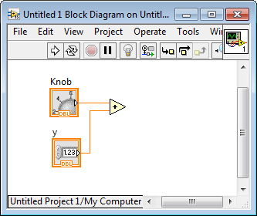
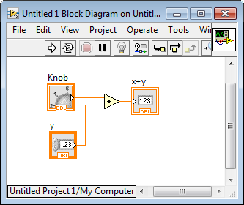
Block Diagram
Right click on the 2nd terminal of “Add”, and choose Create → Control.
Notice also that a control is added to the front panel!
To see the result of addition, right click on the output side of the “Add” icon, and choose Create → Indicator.
Again, an indicator is added to the front panel!
Note: On previous slide, the “Arrow” is broken because there is error in the code.
You can double click to see the error.
Now, the “Arrow” is full meaning that there is no more error.

Slide 22
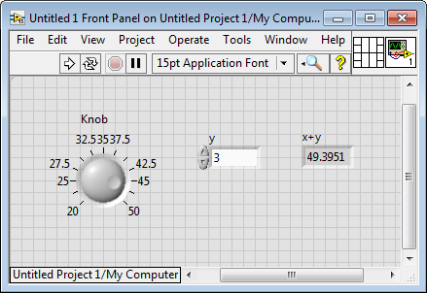
First Trial
Go back to the front panel.
Turn the knob to any number.
Key in any number to the numerical control (y).
Click the white arrow.
You can see the result of the addition shown in the indicator!

Slide 23
Exercise
Assume you have a right triangle.
Key in the lengths of two legs, and calculate the length of hypotenuse.
C = sqrt (A^2 + B^2)

Slide 24
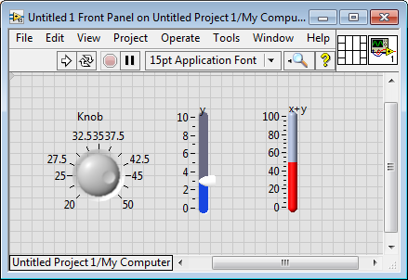
Replacing Items on Front Panel
You may want to use different items rather than the default control and indicators.
Right click on the item → Replace → (Find the desired item)

Slide 25
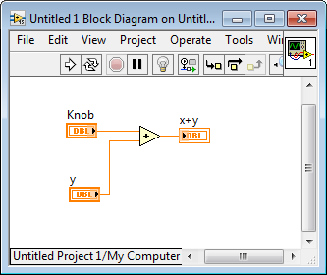
View Terminals as Icons
On the Block Diagram, some of the icons look quite big.
When you have a huge program, the window could become messy.
To make the display more compact:
Right click on the item → uncheck “display as icon” / View As Icon

Slide 26
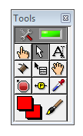
Tools Palette
Recall that when you hover your mouse at the triangle of the Knob, the mouse changes automatically from a cursor to a wiring tool.
You may disable this automatic tool selection if you wish to have some control over the tool.
View → Tool Palette
On/Off Automatic Tool
Operating (e.g. turn knobs, switches)
Positioning and Resizing
Labeling
Wiring
Pop-up
Scroll
Breakpoint (for debugging)
Probe
Copy Colour
Color Tool

Slide 27
The Toolbar
From left to right:
Run: Starts VI execution
Continuous Run: Run until the stop button is pressed
Abort: Stop the VI execution
Pause: For single step debugging
Execution Highlight: To see data flow
Retain Wire Value: Wires will store value that flowed through them the last time the VI was executed. Use Probe to see the value.
Step into, Step over, Step out: For debugging
Text setting.
Align, Distribute, Reorder Object.
Clean up selection / diagram.

Slide 28
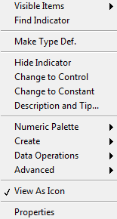
Pop-Up Menus
When you right click on most items, a pop-up menu will appear:

Slide 29
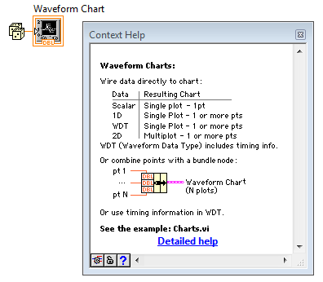
The Help Button
On the upper right hand side of the screen, there is a big question mark “?”
If you click it, and hover around items on your VI, you will see a description of the items.

Slide 30
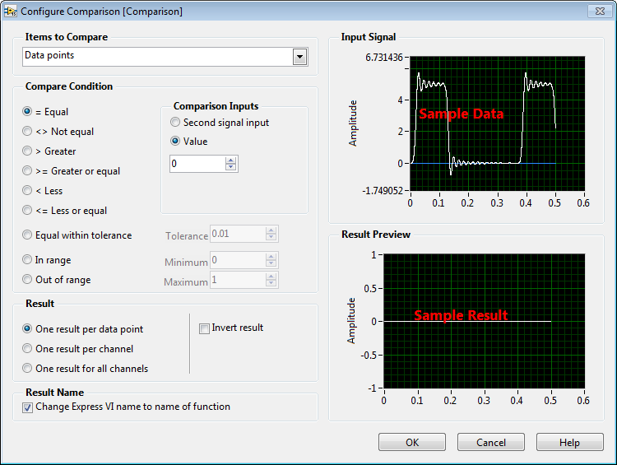

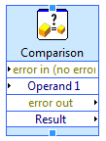
Express VIs
Special kind of LabVIEW functions.
Their behaviour can be defined via a configuration dialogue.
E.g. “Comparison” → “Comparison”
You can resize the SubVIs:
You can also insert or remove some Inputs / Outputs.

Slide 31
Content
Introduction to LabVIEW
The LabVIEW Environment
Getting Started
LabVIEW Foundations

Slide 32
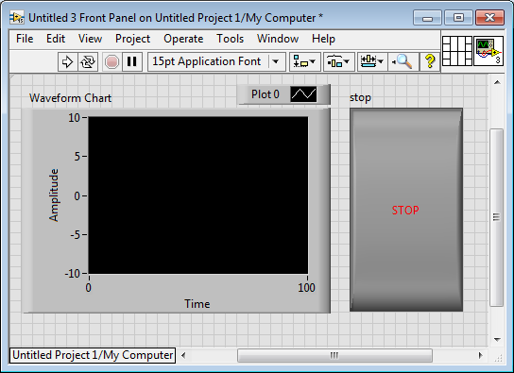
Getting Started
Either delete all the items from your VI previously, or create a new VI under “My Computer”.
Right click on the Front Panel, and choose “Graph” → “Waveform Chart”.
Place it on any desired position on Front Panel.
Right click on the Front Panel again and choose “Boolean” → “Stop Button”.
Place it on Front Panel.
Resize it since you would want to click stop easily!

Slide 33
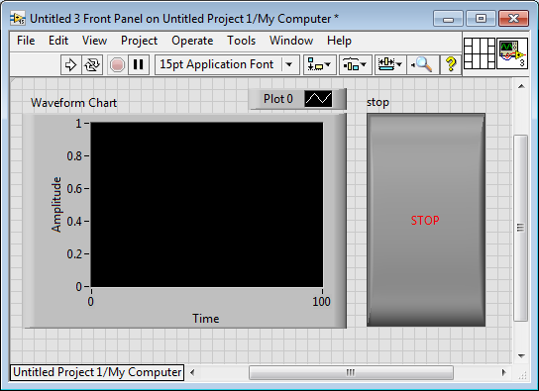
Getting Started
To change the range of the Y-axis, double click “10” and change to “1”.
Also double click “-10” and change to “0”.

Slide 34

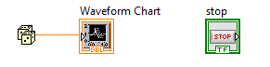
Getting Started
Now, go to the Block Diagram.
You will see that the Stop Button and Waveform Chart terminals are also there.
We will connect wires etc. and make a program out of them.
Right click on the Block Diagram, and select “Numeric” → “Random Numbers”.
Connect the Random Number and the Waveform Chart terminals:

Slide 35
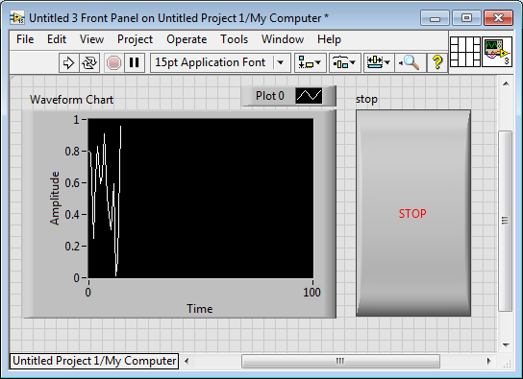
Getting Started
If you click on the White Arrow on top *a few times in a row*, you will see that the Waveform Chart on Front Panel is slowly being filled.

Slide 36
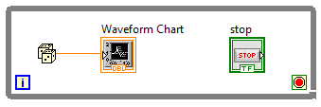
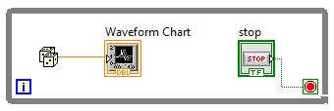
Getting Started
To have this process repeated automatically, we need to tell the program to keep going until we press stop.
This is where the “While” loop comes in.
Go to Block Diagram, select “Structures” → “While Loop”.
Enclose all the items (click and drag the mouse across all, then release).
If you right click on the red button, you will see that it is configured to be “Stop if True”.
Run continuously until a true is given.
Connect the stop button with the red button.

Slide 37
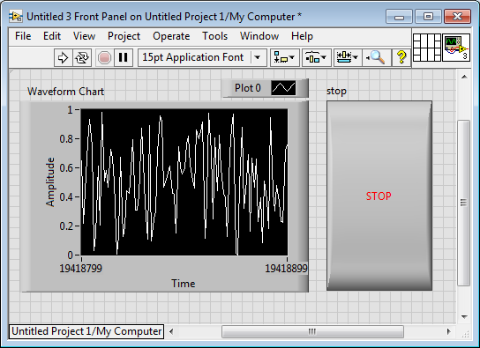
Getting Started
Now click on the White Arrow again, and you will see the process continues by itself.
Press the Stop button when you decide to stop the program.
Save the program as “Random Number.vi”

Slide 38
Exercise
Create a continuous sine wave using the while loop, and show the wave in a chart.
Use to key in omega (frequency) and phase.
Y=sin(omega*t + phase).
Hint: the “i” in the while loop can be used as “t”

Slide 39
Content
Introduction to LabVIEW
The LabVIEW Environment
Getting Started
LabVIEW Foundations

Slide 40
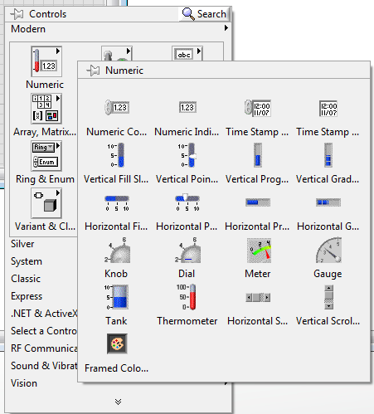

Numeric Controls and Indicators
We have already seen some of these previously:

Slide 41
Numeric Controls and Indicators
Enter and display numeric numbers.
Different representation of data to help use memory more effectively:
E.g. unsigned instead of signed if only positive value expected; integer instead of double if only integers are used.
Representation | Abbre-viation | Size (bytes) | Representation | Abbre-viation | Size (bytes)
Byte | I8 | 1 | Unsigned quad | U64 | 8
Unsigned byte | U8 | 1 | Single precision | SGL | 4
Word | I16 | 2 | Double precision | DBL | 7
Unsigned word | U16 | 2 | Extended precision | EXT | 10ª/12^{b}/16^{c}
Long | I32 | 4 | Complex single | CSG | 8
Unsigned long | U32 | 4 | Complex double | CDB | 16
Quad | I64 | 8 | Complex extended | CXT | 20ª/24^{b}/32^{c}

Slide 42
Numeric Controls and Indicators
You can change the representation of numeric constants.
Pop up the object and select “Representation”.
If memory requirement is a concern, use the smallest representation which will not lose any information.
Check “Adapt to Source” in pop-up menu.
Format and precision *of display only, not internal accuracy*
Pop up and select “Display Format”.
“Digits of precision” means number of digits to the right of decimal point.
4 digits of precision
4 significant digits

Slide 43
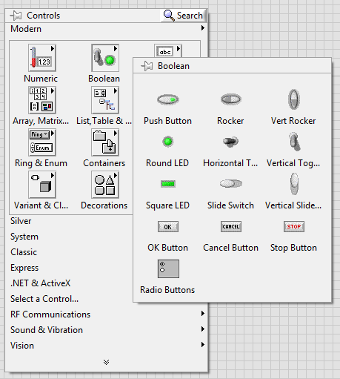
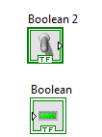
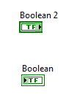
Boolean
On or Off

Slide 44
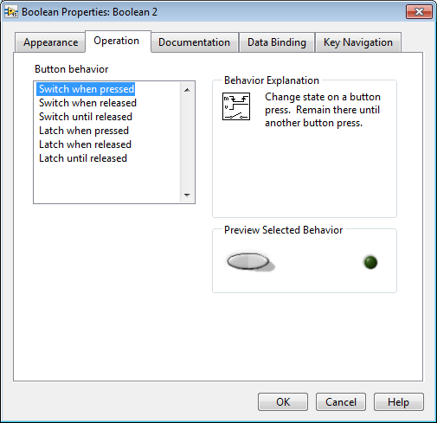
Boolean
Mechanical actions:
Pop-up → Properties → Actions

Slide 45
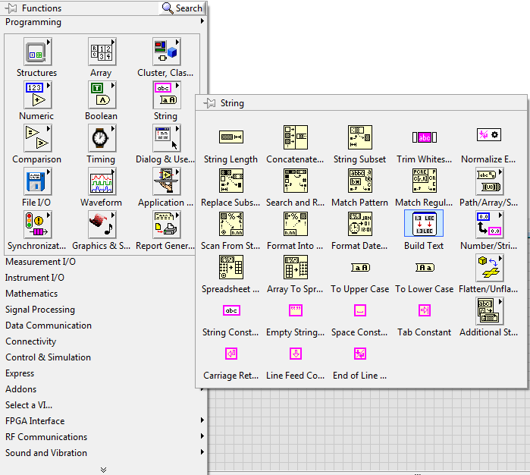


Strings
Display text data.
Strings most often contain data in ASCII format.
E.g.
Pop-up options:
Enable wrapping
Limit to single line
“Enter” applies the value to the string, instead of starting a new line

Slide 46
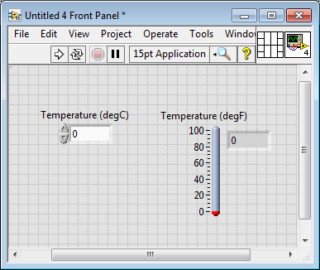
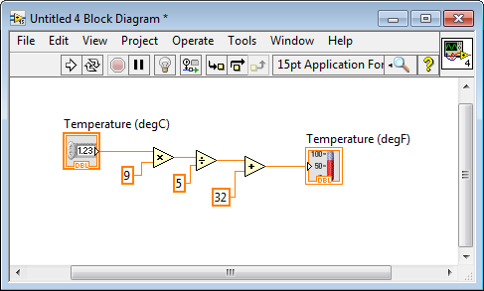
Example: Convert Celcius to Fahrenheit
degF = degC x 9/5 + 32
Note:
Change labels
Visible items → Digital display

Slide 47
Exercise
Build a VI which generates a random number between zero and ten, then divide by an given number. If the input number is zero, the VI lights an LED to flag it as “divide by zero” error.

Slide 48
Thank you!
Any Questions?

